Slide 1
Basic Details of the Team and Problem Statement
Problem Statement Title :Chatbot to respond to text queries pertaining to various acts ,rules ,and regulations applicable to mining industries.
PS Code:SIH1312
Team Name: CHATMINDS
Team Leader Name: Sai Surya teja
Theme Name: Smart Automation

Slide 2
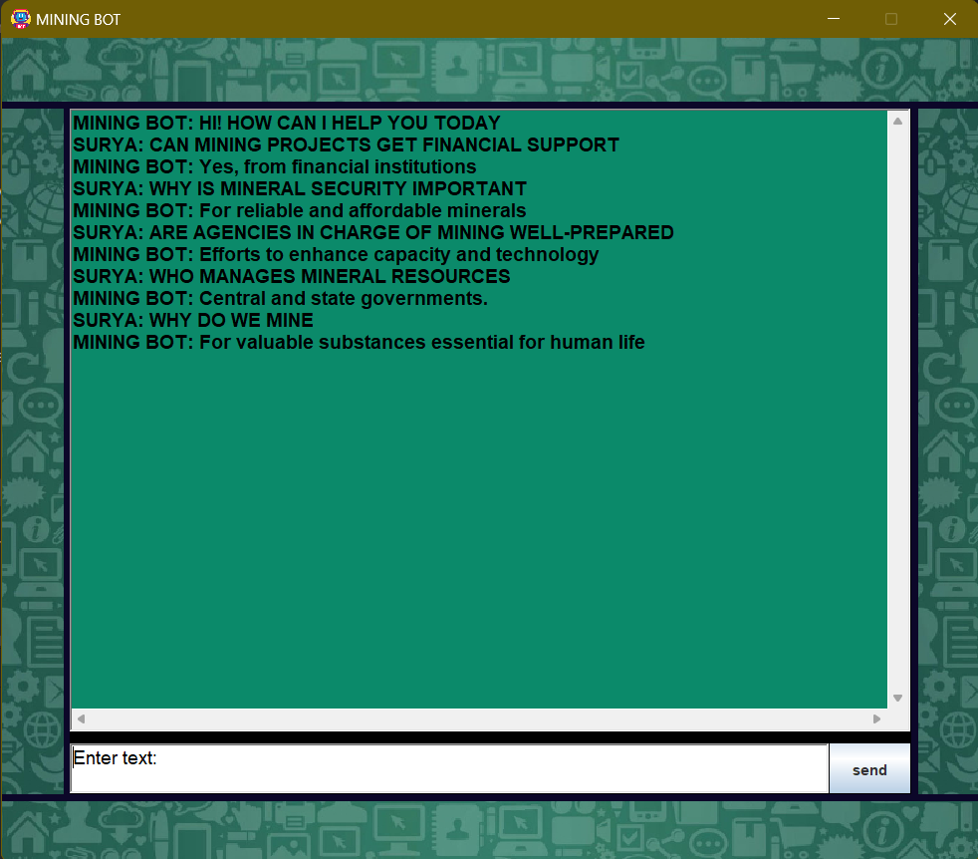
Idea/Approach Details
Add process flow chart or simulated image of prototype or any relevant image related to your idea
Describe your idea/Solution/Prototype here:
We are developing the chatbot using java-[GUI] interface for establishing with user and the chatbot.
We Aim at integrating the chatbot with the official government website for easier access.
We are developing the chatbot so that it responds to the user in all cases of inputs miss match using the pattern matching algorithmns.
We aim at taking feedback related to the chatbot user experience and incorporate it in our later versions.
We aim at developing the chatbot such a way that it provides legit and necessary information with an high accuracy.
We are using the data provided by government at https://mines.gov.in/webportal/home for legit and accurate data.
Describe your Technology stack here:
programming language- JAVA
Graphical user interface [GUI]- JAVA SWING
Pattern matching algorithms-Brute force
IDE[integrated development environment]
Data structures – hash map

Slide 3
Idea/Approach Details
Describe your Use Cases here
Describe your Dependencies / Show stopper here
Our chatbot can respond to various questions posed by the user.
Our chatbot can quickly retrieve data from a large Data source and respond the users with relevant answers/responses.
It can be easily with official government website for mining ,So that the users can use it conveniently.
It can also provide quick guidelines, advices whenever there is an emergency in mines.
The mining companies can use our chatbot as a tool training there employees related to the mining.
Our chatbot also serves as tool for legal advisors who can use our chatbot for getting legal laws regarding mining.
Government officials in the mining department can now easily retrieve the information without looking at large amount of files.
Currently we aren’t able to use pattern matching algorithms more efficiently for achieving the higher precise responses.

Slide 4
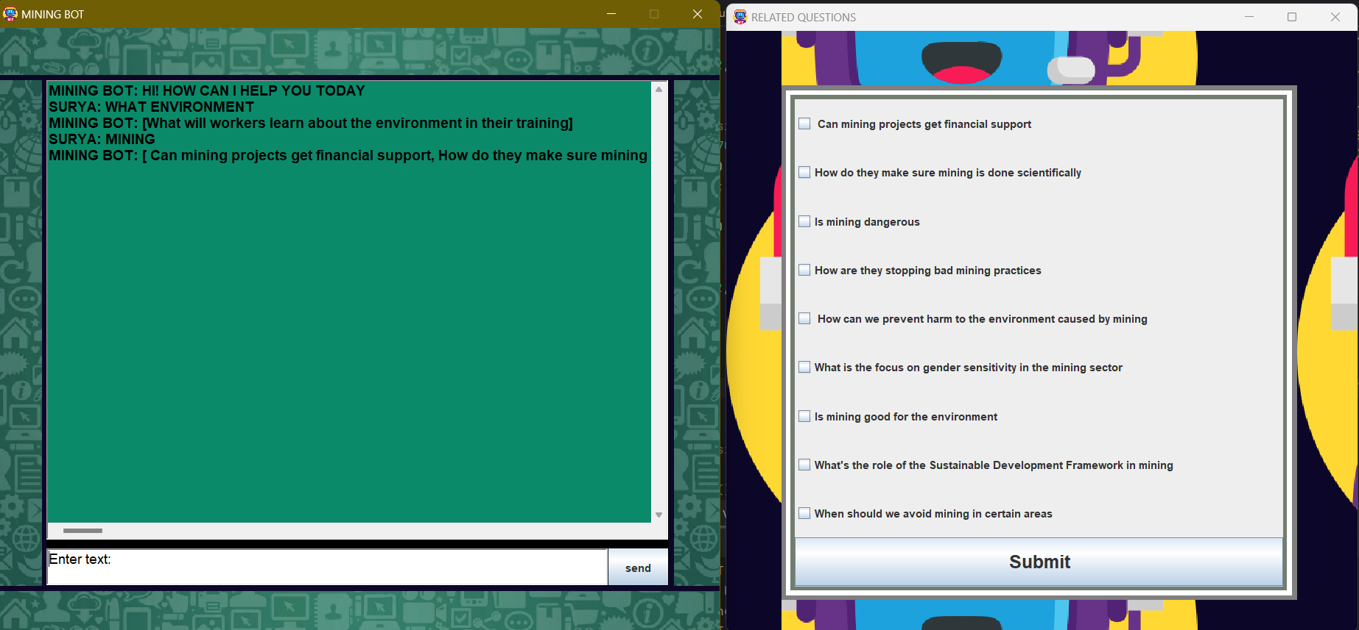
Idea/Approach Details

Slide 5
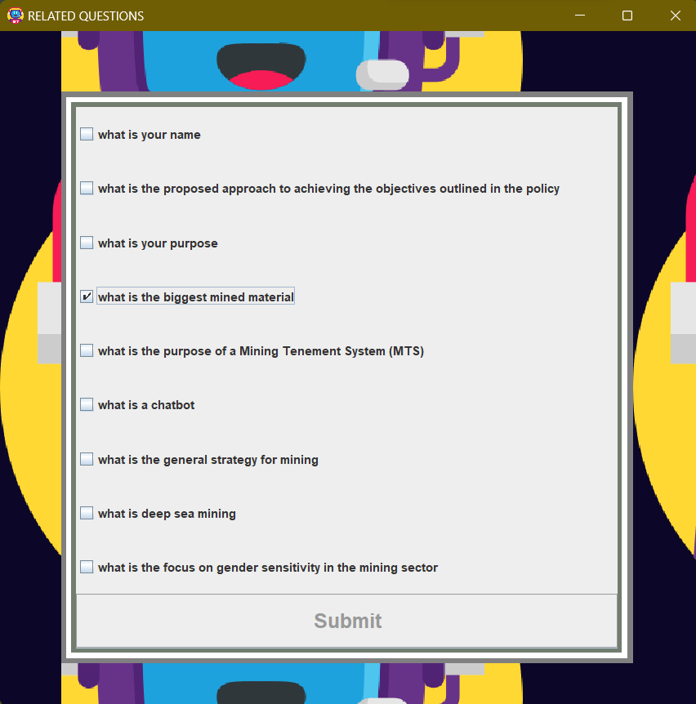
RELATED QUESTIONS WINDOW

Slide 6
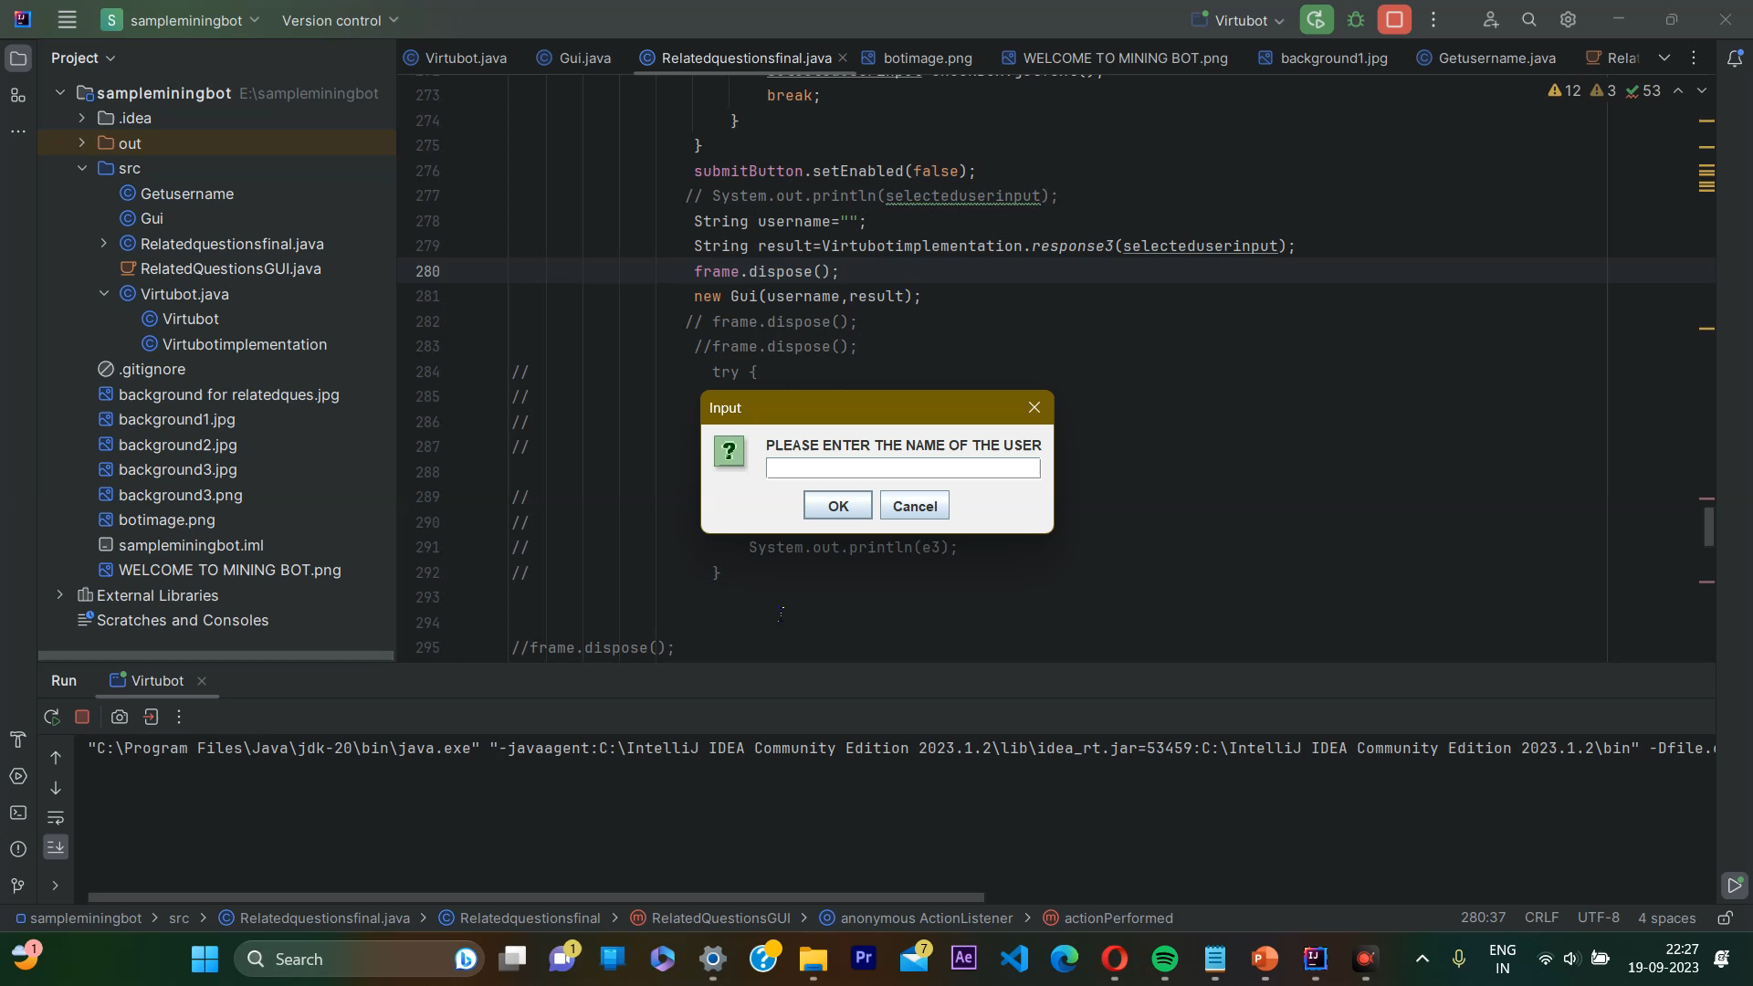
RELATED QUESTIONS WINDOW

Slide 7
Team Member Details
Team Leader Name: Sai Surya teja
Branch (Btech): Btech Stream (ECE, CSE etc): CSE Year (I,II,III,IV): III
Team Member 1 Name: Aryan M
Branch (Btech): Btech Stream (ECE, CSE etc): CSE Year (I,II,III,IV): III
Team Member 2 Name: Ravi charan
Branch (Btech): Btech Stream (ECE, CSE etc): CSE Year (I,II,III,IV): III
Team Member 3 Name: Y Vindhya
Branch (Btech): Btech Stream (ECE, CSE etc): CSE Year (I,II,III,IV): III
Team Member 4 Name: Pravija M
Branch (Btech): Stream (ECE, CSE etc): CSE Year (I,II,III,IV): III
Team Member 5 Name: Sushmitha v
Branch (Btech): Stream (ECE, CSE etc): CSE Year (I,II,III,IV): III
Team Mentor 1 Name: DR MICHAEL
Category (Academic/Industry): Academic Expertise (AI/ML/Blockchain etc): AI/ML Domain Experience (in years):
Team Mentor 2 Name: Type Your Name Here
Category (Academic/Industry): Expertise (AI/ML/Blockchain etc): Domain Experience (in years):

